Slide 1
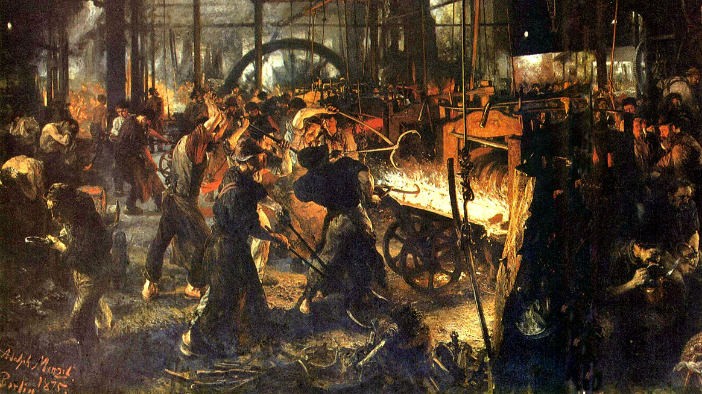
What traits do we conventionally or stereotypically associate with wolves?

Slide 2
Life in the Iron Mills (1861)
Adolf von Menzel, Iron Rolling Mill ca. 1872

Slide 3
Structure:
Framing section describing the mill town and the house the characters lived in.
Principal episode: “a night, a crisis in the life of one man”
Aftermath: a month later at the jail
Return to the frame, narrator’s library, and statue of the korl woman

Slide 4
Characters—Hugh and His Extended Family:
Hugh Wolfe
Deborah Wolfe
Janey
“I choose the half-forgotten story of this Wolfe”
“It is nearly thirty years since the Wolfes lived here.”
‘inclining for a moment to show fight, and drag the woman Wolfe off with them”
“I want you to come down and look at this Wolfe, standing there among the lowest of his kind . . . .”
Notes:
Hugh Wolfe- a lone wolf, a wolfe in sheeps clothing- he is not what he appears, unintentially deceptive.

Slide 5
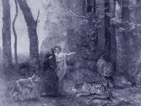
Dante, Inferno, Canto 1
Notes:
The iron mill is like Dante’s inferno, one of the isitors talks about a specific character in Dantes inferno.
In the beginning of Dante’s inferno, he is confronted by a lion, leapord, and wolf stopping him from what he needs to do. Lion represents violience, wolf-unrestrained desire, leapord-deception
Wolf is represented as personification or allegorical image of desire- it is hungry/straved

Slide 6
There was not one line of beauty or grace in it: a nude woman's form, muscular, grown coarse with labor, the powerful limbs instinct with some one poignant longing. One idea: there it was in thetense, rigid muscles, the clutching hands, the wild, eager face, like that of a starving wolf's.
I see a bare arm stretched out imploringly in the darkness, and an eager, wolfish face watching mine: a wan, woful face, through which the spirit of the dead korl-cutter looks out, with its thwarted life, its mighty hunger, its unfinished work.
Notes:
Wolfe has an intellectual hunger, hungry for a different environment. He is hungry to practice/develop his art, hungry for beauty in some ways

Slide 7
Three Outsiders:
““You say the pocket and the heart of the world speak without meaning to these people. What has its head to say? Taste, culture, refinement? Go!”

Slide 8
Breakout Group Discussions:
Each group should review the encounter between Hugh and the three visitors to the mill (starting at “Wolfe, while Deborah watched” and ending at “T be late, Hugh”).
Each group should then talk through and prepare to present a character sketch for one of the three visitors: Kirby, May, or Mitchell. Be sure to consider the following questions, and be prepared to cite evidence to support your assertions.
What is the character’s occupation or interests?
What is the character’s attitude toward workers in general or Hugh in particular or toward the korl statue of a woman?

Slide 9
Kirby:
“Ce n'est pas mon affaire. I have no fancy for nursing infant geniuses.
I suppose there are some stray gleams of mind and soul among these
wretches. “
“If I had the making of men, these men who do the lowest part of the world's work should be machines,--nothing more,--hands. It would be kindness. God help them! What are taste, reason, to creatures who must live such lives as that?”
Notes:
Kirby is the “pocket of the world” money hungry. Dismissive and condescending towards Hugh

Slide 10
Dr. May:
Something of a vague idea possessed the Doctor's brain that much good was to be done here by a friendly word or two: a latent genius to be warmed into life by a waited-for sunbeam. . . . So he went on complacently:
“Do you know, boy, you have it in you to be a great sculptor, a great man? do you understand?” (talking down to the capacity of his hearer: it is a way people have with children, and men like Wolfe,)--“to live a better, stronger life than I, or Mr. Kirby here? A man may make himself anything he chooses. God has given you stronger powers than many men,--me, for instance. . . . Make yourself what you will. It is your right.”
Notes:
Dr. May is the heart

Slide 11
Dr. May:
Something of a vague idea possessed the Doctor's brain that much good was to be done here by a friendly word or two: a latent genius to be warmed into life by a waited-for sunbeam. . . . So he went on complacently:
“Do you know, boy, you have it in you to be a great sculptor, a great man? do you understand?” (talking down to the capacity of his hearer: it is a way people have with children, and men like Wolfe,)--“to live a better, stronger life than I, or Mr. Kirby here? A man may make himself anything he chooses. God has given you stronger powers than many men,--me, for instance. . . . Make yourself what you will. It is your right.”

Slide 12
Mitchell:
“a man who sucked the essence out of a science or philosophy in an indifferent, gentlemanly way; . . . accepting all, despising nothing, in heaven, earth, or hell, but one-idead men; with a temper yielding and brilliant as summer water, until his Self was touched, when it was ice, though brilliant still.”
“Reform is born of need, not pity. No vital movement of the people's has worked down, for good or evil; fermented, instead, carried up the heaving, cloggy mass. Think back through history, and you will know it. . . . Some day, out of their bitter need will be thrown up their own light-bringer,--their Jean Paul [Marat] their Cromwell, their Messiah.”
Notes:
Head

Slide 13
Mitchell:
“a man who sucked the essence out of a science or philosophy in an indifferent, gentlemanly way; . . . accepting all, despising nothing, in heaven, earth, or hell, but one-idead men; with a temper yielding and brilliant as summer water, until his Self was touched, when it was ice, though brilliant still.”
One idea: there it was in the tense, rigid muscles, the clutching hands, the wild, eager face, like that of a starving wolf's.

Slide 14
Three Outsiders:
The Doctor had held out his hand in a frank, generous way, telling him to “take care of himself, and to remember it was his right to rise.” Mitchell had simply touched his hat, as to an equal, with a quiet look of thorough recognition. Kirby had thrown Deborah some money, which she found, and clutched eagerly enough.

Slide 15
Meanings of Visitor’s Names:
Clarke—the “overseer” (supervisor) from “clerk” (an officer who superintends conduct of a business)
Mitchell—from Michael (“who is like God”)
May—”to be able to be or do”
Kirby--?

Slide 16
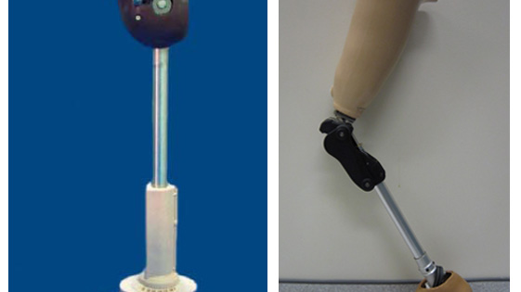
Narrative Prosthesis

Slide 17
Narrative Prosthesis: How does Life in the Iron Mills depend upon disability?

Slide 18
From Short Stories for Students
“"Life in the Iron Mills" is set mostly in the 1830s in an unnamed town that is based on the author's hometown of Wheeling, Virginia. It tells the tragic story of two Welsh immigrants. Hugh Wolfe is a young man who works long hours in the oppressive heat at the local foundry; his cousin Deborah works at the cotton mill. They live in poverty. Although uneducated and illiterate, Wolfe is a man of great artistic sensibility who longs to escape his daily drudgery and live a more meaningful life, but circumstances conspire against him.”

Slide 19
From Wikipedia Article “The (In)visibility of Prosthesis”
Life in the Iron Mills is a short story (or novella) written by Rebecca Harding Davis in 1861, set in the factory world of the nineteenth century. It is one of the earliest American realist works, and is an important text for those who study labor and women's issues.^{[1][2]} It was immediately recognized as an innovative work, and introduced American readers to "the bleak lives of industrial workers in the mills and factories of the nation.”

Slide 20
Beginning with Deb
One rainy night, about eleven o'clock, a crowd of half-clothed women stopped outside of the cellar-door. They were going home from the cotton-mill.
“Good-night, Deb,” said one, a mulatto, steadying herself against the gas-post. She needed the post to steady her. So did more than one of them.

Slide 21
Ending with Deb
There is a woman, old, deformed, who takes a humble place among them: waiting like them: in her gray dress, her worn face, pure and meek, turned now and then to the sky. A woman much loved by these silent, restful people; more silent than they, more humble, more loving. Waiting: with her eyes turned to hills higher and purer than these on which she lives, dim and far off now, but to be reached some day. There may be in her heart some latent hope to meet there the love denied her here,—that she shall find him whom she lost, and that then she will not be all-unworthy. Who blames her?

Slide 22
Succumbing to Temptation
A consciousness of power stirred within him. He stood up. A man,--he thought, stretching out his hands,--free to work, to live, to love! Free! His right! He folded the scrap of paper in his hand. As his nervous fingers took it in, limp and blotted, so his soul took in the mean temptation, lapped it in fancied rights, in dreams of improved existences, drifting and endless as the cloud-seas of color.

Slide 23
Rights and the Devil’s Whispering
“I must gif it to him,” he said, reading her face.
“Hur knows,” she said with a bitter sigh of disappointment. “But it is hur right to keep it.”
His right! The word struck him. Doctor May had used the same. He washed himself, and went out to find this man Mitchell. His right! Why did this chance word cling to him so obstinately? Do you hear the fierce devils whisper in his ear, as he went slowly down the darkening street?

Slide 24
Deborah’s Motivations--Love
Deeper yet if one could look, was there nothing worth reading in this wet, faded thing, half covered with ashes? no story of a soul filled with groping passionate love, heroic unselfishness, fierce jealousy? of years of weary trying to please the one human being whom she loved, to gain one look of real heart-kindness from him?

Slide 25
Deborah’s Motivations--Unlovable
She knew, in spite of all his kindness, that there was that in her face and form which made him loathe the sight of her. . . . She knew, that, down under all the vileness and coarseness of his life, there was a groping passion for whatever was beautiful and pure, that his soul sickened with disgust at her deformity, even when his words were kindest.

Slide 26
Deborah’s Motivations—”Akin to Beauty”
The candle flared a pale yellow light over the cobwebbed brick walls, and the woman standing there. He looked at her. She was young, in deadly earnest; her faded eyes, and wet, ragged figure caught from their frantic eagerness a power akin to beauty.
“Hugh, it is true! Money ull do it!

Slide 27
Does Deb’s disability work this way?
first, a deviance or marked difference is exposed to a reader;
second, a narrative . . . call[s] for an explanation of the deviation's origins and . . . consequences;
third, the deviance is brought from the periphery of concerns to the center of the story to come;
and fourth, the remainder of the story rehabilitates or fixes the deviance in some manner.

Slide 28
Is this true of Life in the Iron Mills?
“Yet the reliance upon disabil­ity in narrative rarely develops into a means of identifying people with dis­abilities as a disenfranchised cultural constituency. The ascription of absolute singularity to disability performs a contradictory operation: a char­acter "stands out" as a result of an attributed blemish, but this exceptional­ity divorces him or her from a shared social identity.” (55)

Slide 29
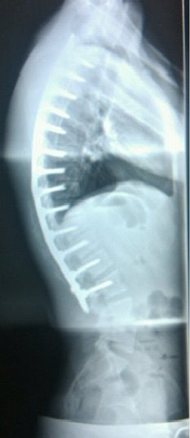
Materiality of Metaphor
“In the second instance, disability [and the disabled body] also serves as a metaphorical signifier of social and individual collapse. . . . stories rely upon the potency of disability as a symbolic figure” (47-48)

Slide 30
Materiality of Metaphor
Within such a representational schema, literary narratives revisit disabled bodies as a reminder of the "real" physical limits that "weigh down" transcendent ideals of the mind and knowledge-producing disciplines. (49)

Slide 31
“A type of her class”
Miserable enough she looked, lying there on the ashes like a limp, dirty rag,--yet not an unfitting figure to crown the scene of hopeless discomfort and veiled crime: more fitting, if one looked deeper into the heart of things, at her thwarted woman's form, her colorless life, her waking stupor that smothered pain and hunger,--even more fit to be a type of her class.

Slide 32
Are all Welsh laborers “almost a hunchback”?
“You may pick the Welsh emigrants, Cornish miners, out of the throng passing the windows, any day. They are a trifle more filthy; their muscles are not so brawny; they stoop more. When they are drunk, they neither yell, nor shout, nor stagger, but skulk along like beaten hounds.”
“Wolfe, while Deborah watched him as a spaniel its master, bent over the furnace with his iron pole, . . . .”

Slide 33
Disease as Metaphor
“If you could go into this mill where Deborah lay, and drag out from the hearts of these men the terrible tragedy of their lives, taking it as a symptom of the disease of their class, no ghost Horror would terrify you more.”
““Yes, money,--that is it,” said Mitchell, rising, and drawing his furred coat about him. “You've found the cure for all the world's diseases.--Come, May, find your good-humor, and come home.”

Slide 35
Physically, Nature had promised the man but little. He had already lost the strength and instinct vigor of a man, his muscles were thin, his nerves weak, his face ( a meek, woman's face) haggard, yellow with consumption. In the mill he was known as one of the girl-men: “Molly Wolfe” was his sobriquet. He was never seen in the cockpit, did not own a terrier, drank but seldom; when he did, desperately.

